Slide 1
ME1306 PMAC Motor
Axial Flux, Surface Permanent Magnet Rotor
AF, SPM, PMAC Motor
Open Frame, Fan Cooled
Drop-in Replacement for ME0913 Motor

Slide 2
Product Specification
Designed for 24 to 96 VDC battery applications
Continuous Output of 12.6 kw on 96 VDC battery systems (38 kw peak)
Maximum rotor speed is 5,000 rpm (Passes 8,000 rpm rotor burst test)
Open Frame, Fan Cooled motor IP20
UL Insulation system, Class H 180 C for 20,000 hours
Designed to meet NEMA 1004 standards
NTN6006 LLUC3/5K sealed ball bearing (Made in Japan)
Hall Sensor Rotor Position Sensor (Optional Sine/Cosine)
Weight of 36 pounds (16 kg)

Slide 3
Product Specification
Continuous Current of 150 Amps (Sevcon Size 6 Control)
Peak Current of 450 amps
Continuous Torque of 220 Lb In (24 Nm)
Peak Torque of 660 Lb In (72 Nm)
Options:
Motor Part Number ME1115 for Sine/Cosine rotor sensor
Metric Shaft and Mounting face
Windings for maximum speeds of 300-5000 rpm
Totally enclosed case
Optional 10,000 hour bearing set
Optional Phase Lead Cover

Slide 4
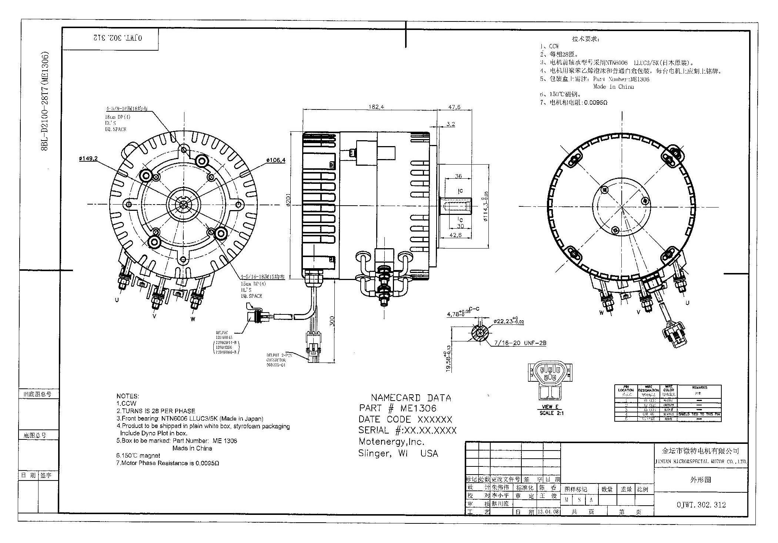

Slide 5
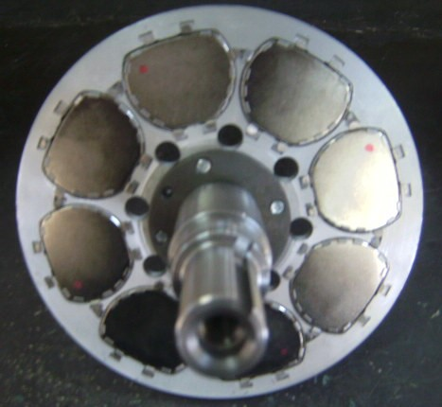
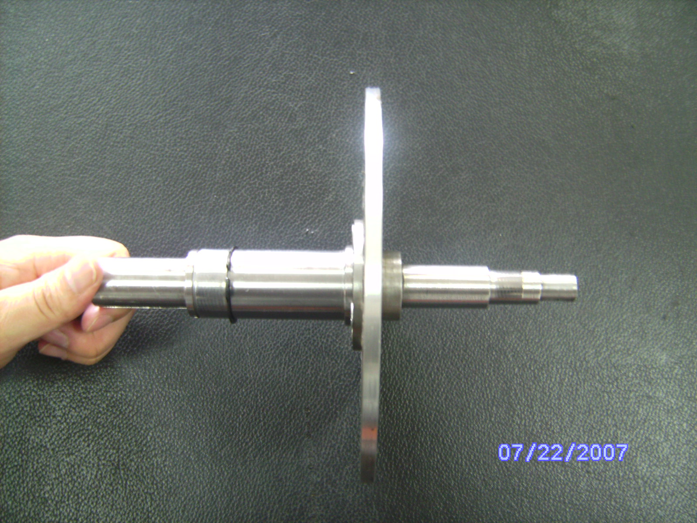
Rotor Specifications
150 C rating (180 C Optional)
Sinusoidal Back-EMF
Neodymium Magnets
Passes GM Salt Spray Test
Nichol Plated
Low Inertia for rapid accelerations

Slide 6
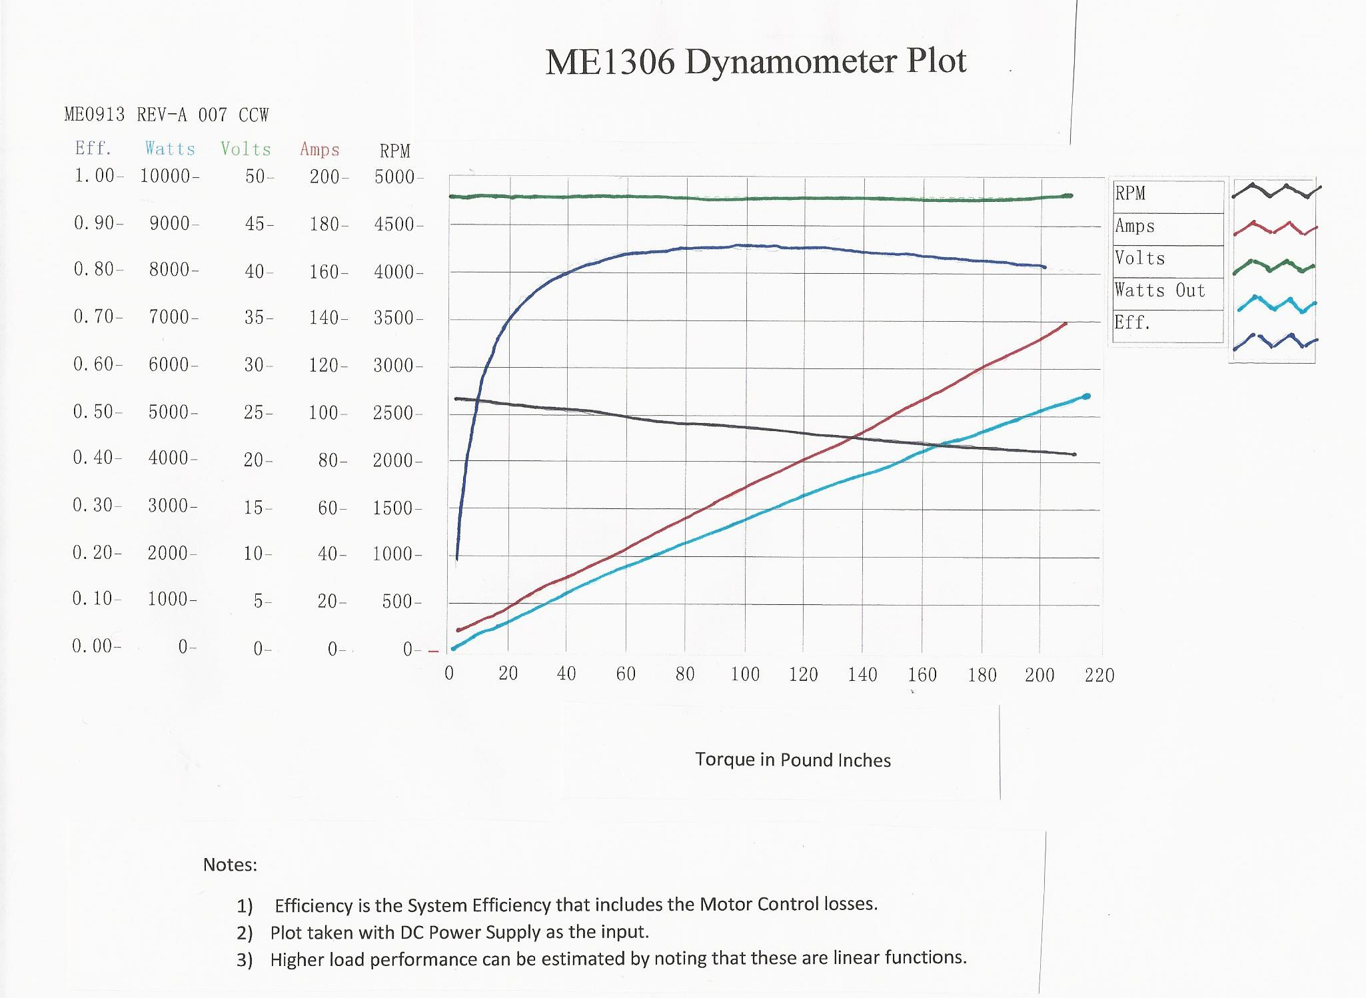

Slide 7
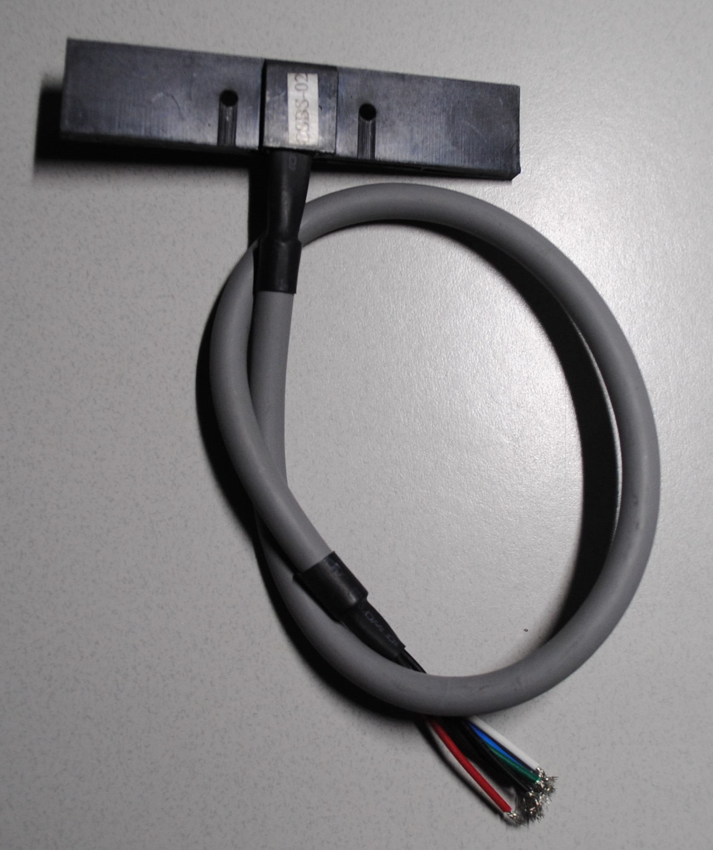
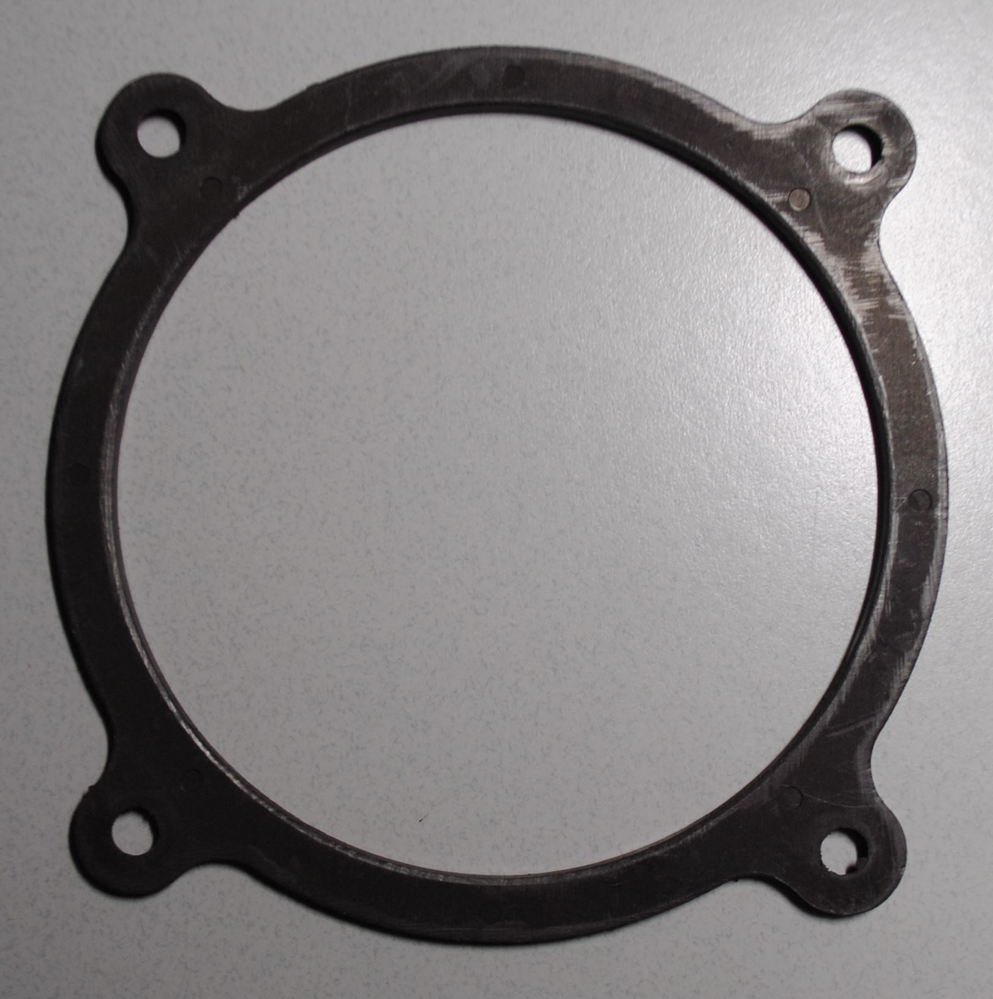
Rotor Position Sensor
Three hall sensors, Part Number MLX92211 from Melexis
Added noise suppression circuitry for EMI/RFI
Operating voltage of 4 to 24 VDC
Commutation set for 180 electrical degrees
Hall Sensors on circuit board in a potted (epoxy filled) module rated IP67
Target Magnet Ring
Plastic Magnet
Charged 8 poles

Slide 8
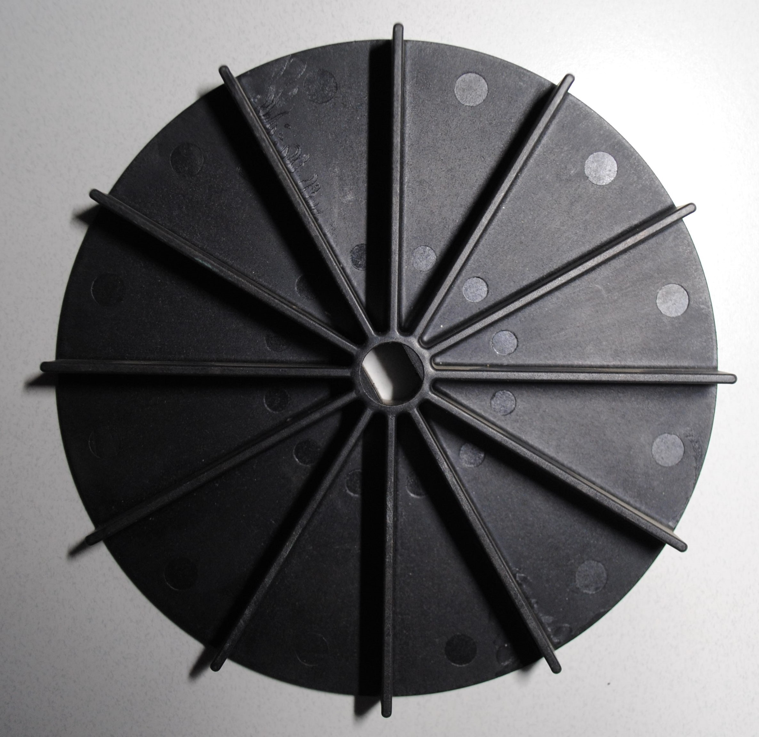
Bi-Directional Fan
Same air flow in both directions
Pulls air through motor, from the output shaft side to the rear of the motor
Lightweight, low inertial plastic fan, made from UL Listed, non-flammable material

